Slide 1

ILP 2021 – W4S1a Testing, asserting and debugging
Matthieu DE MARI – Singapore University of Technology and Design

Slide 2
Outline (Week4, Session1a – W4S1a)
Testing
Unit testing
Assertion testing
Integration testing
Debugging and practice

Slide 3

Testing: a definition?
“Program testing can be used to show the presence of bugs, but never to show their absence!” – Edsger W. Dijkstra

Slide 4
Testing: a definition?
“Program testing can be used to show the presence of bugs, but never to show their absence!” – Edsger W. Dijkstra
FYI: Dijkstra is famous for his algorithm, used for path-finding in many applications (GPS, video games, etc.)

Slide 5
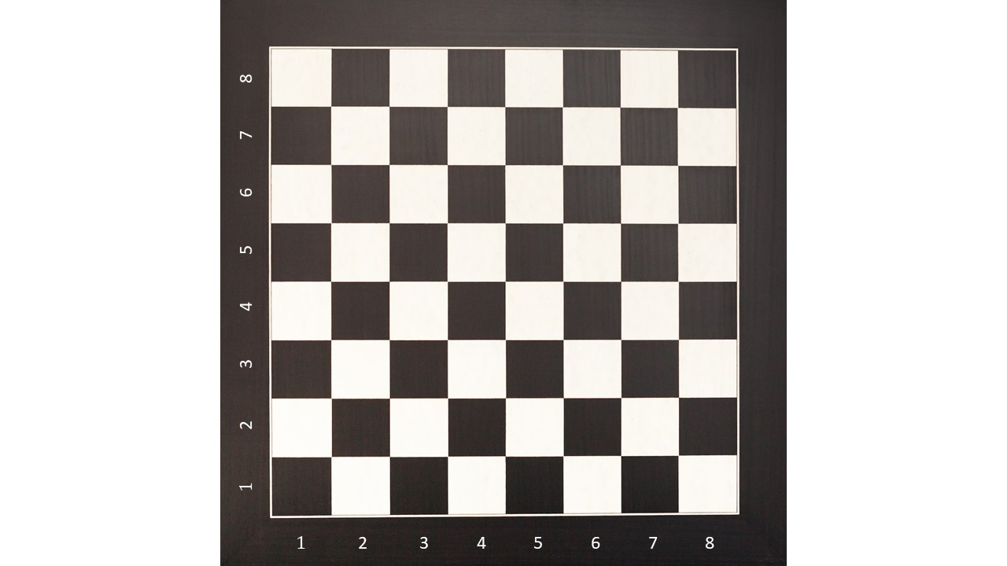
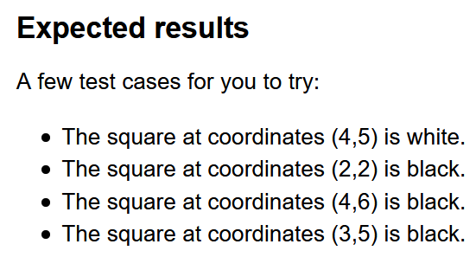
Testing: a definition?
Program testing is the process of executing a program, with the objective of finding errors.
Program testing cannot show the absence of errors. It can only show if errors are present.
It is possible to identify and write the tests before the program. → Test driven development.

Slide 6
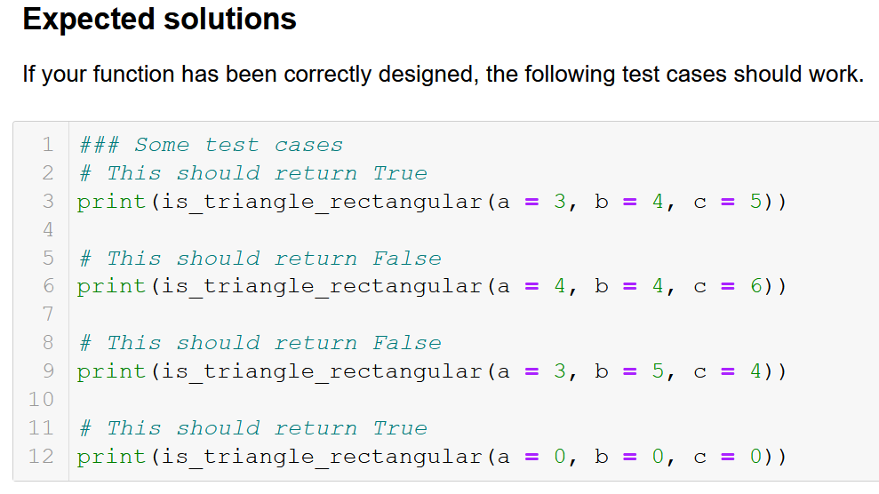
Limits of testing
Issue #1: Program testing cannot show the absence of errors. It can only show if errors are present.
Issue #2: In the ideal world, all possible paths through a programs should be tested.
But it is often impossible.
E.g., I can test all squares of an 8x8 grid, because there is a finite number of them.
But I cannot test all possible integers, lists of integers, etc.

Slide 7
Unit testing
Unit testing: test cases, whose objective is to verify that a single function is able to operate as expected.
Often a good idea to start simple, and progressively look for more complex/special cases.

Slide 8
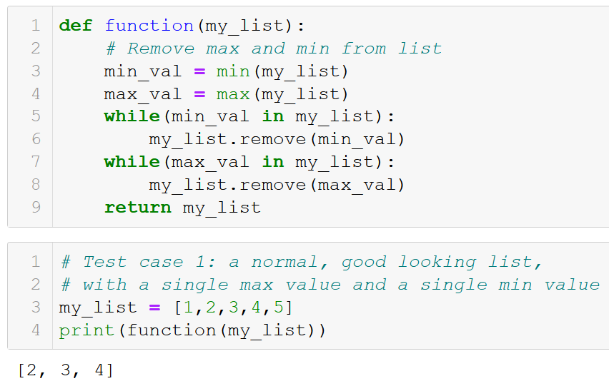

Slide 9
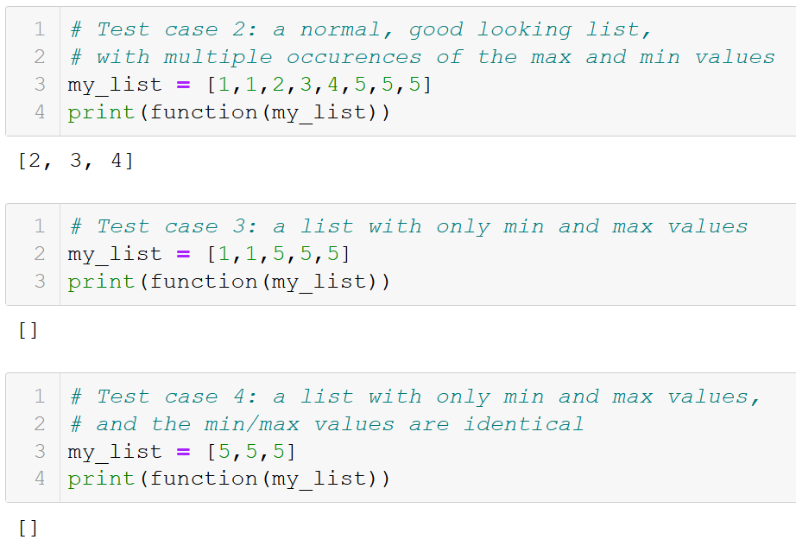

Slide 10
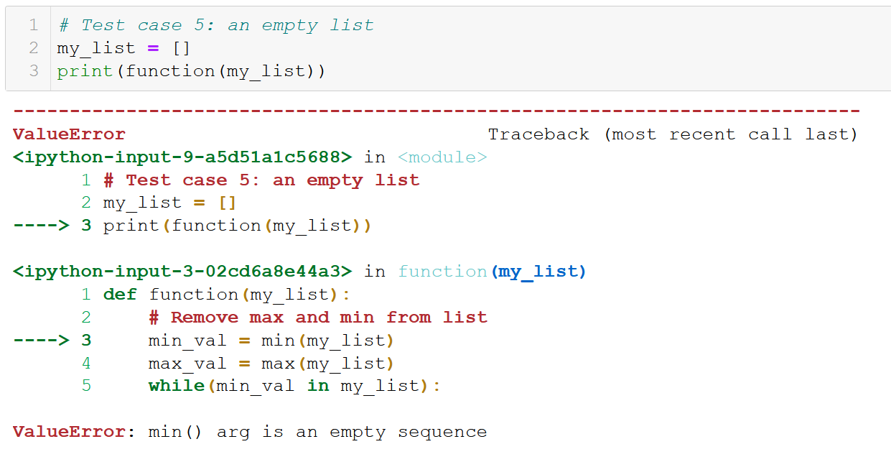

Slide 11
Unit testing
Unit testing: test cases, whose objective is to verify that a single function is able to operate as expected.
Often a good idea to start simple, and progressively look for more complex/special cases.
Whenever a test case is identified as not working, amend the function to cover for this special case if needed.

Slide 12
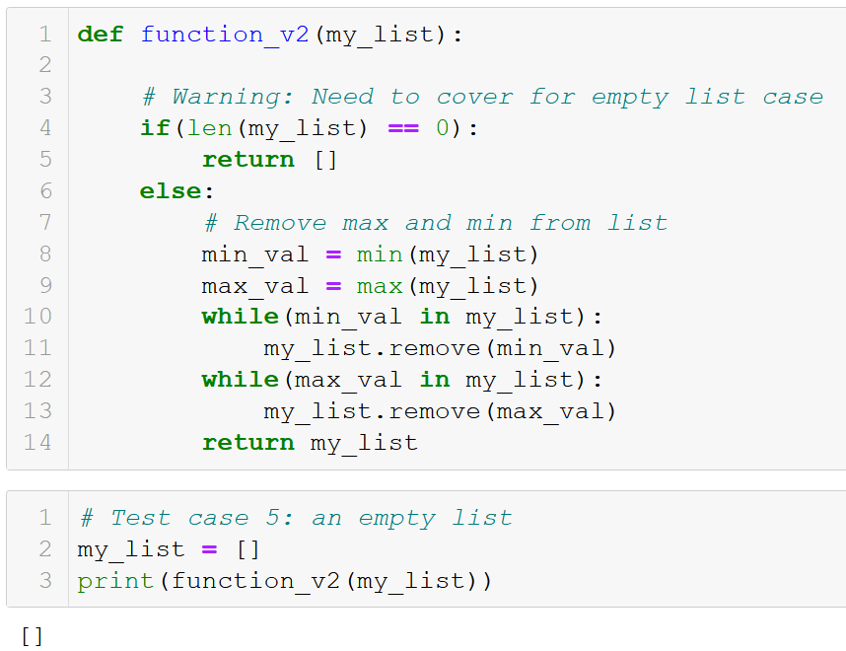

Slide 13
Unit testing
Unit testing: test cases, whose objective is to verify that a single function is able to operate as expected.
Often a good idea to start simple, and progressively look for more complex/special cases.
Whenever a test case is identified as not working, amend the function to cover for this special case if needed.
Unit testing is a cat-and-mouse game!

Slide 14
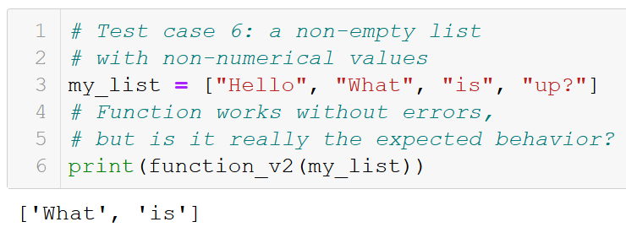
Unit testing is essential…
But ultimately, it is never enough.
It is a never ending task, as it will never be able to cover for all possible ways to break our function.

Slide 15
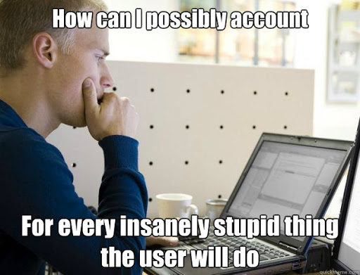
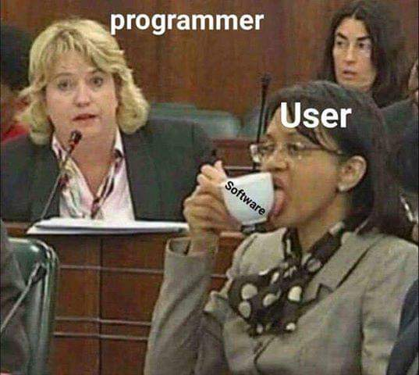
Finding the right balance?

Slide 16
Assertion testing
In some (stupid) cases, the function should simply refuse to operate.
Instead, it should check that the function is indeed being used in its “normal” setting.
And raise error messages to inform the user that he/she is misusing the function, if so.
That is called assertion testing.

Slide 17
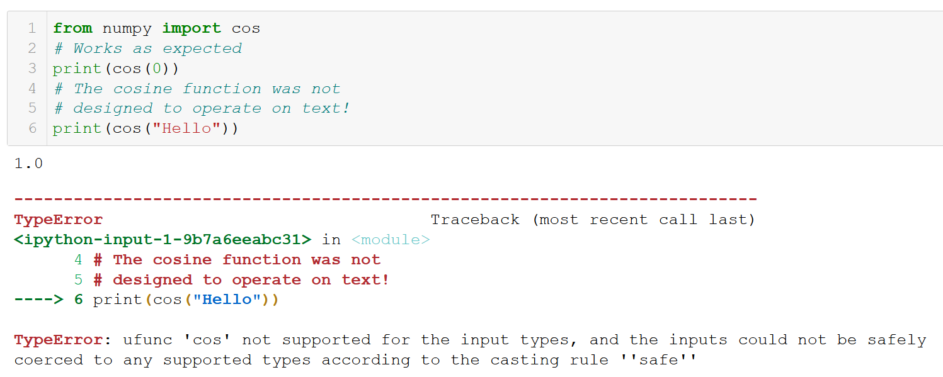
Assertions
In some (stupid) cases, the function should simply refuse to operate.
Instead, it should check that the function is indeed being used in its “normal” setting.
And raise error messages to inform the user that he/she is misusing this function, if so.
That is called assertion testing.

Slide 18
The assert Keyword
The assert keyword is used for assertion testing.
It is the most basic error control structure; whose objective is to verify that a function/program is being used in its intended purpose/configuration.

Slide 19
The assert Keyword
The assert keyword is used for assertion testing.
It is the most basic error control structure; whose objective is to verify that a function/program is being used in its intended purpose/configuration.
It receives a Boolean and a message in string format.
If the Boolean is True, nothing happens.
If False, the program crashes on purpose and the message is displayed as an error.

Slide 20
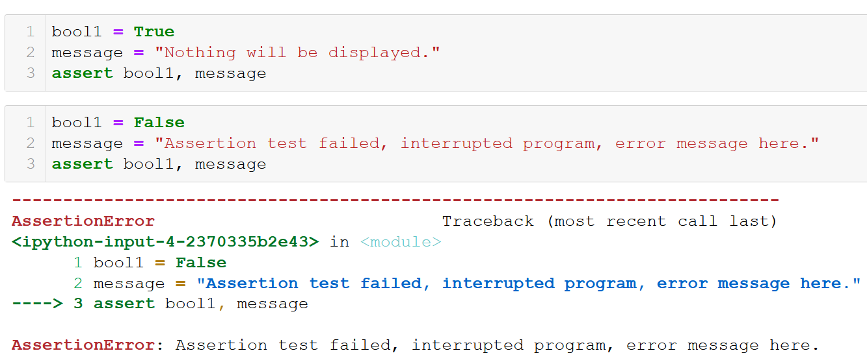
The assert Keyword

Slide 21
The assert Keyword
The assert keyword is used for assertion testing.
It is the most basic error control structure; whose objective is to verify that a function/program is being used in its intended purpose/configuration.
Typically used to check
That a user entered digits only, when prompted with input(),
Mathematical functions are used with numerical types variables,
Etc.

Slide 22
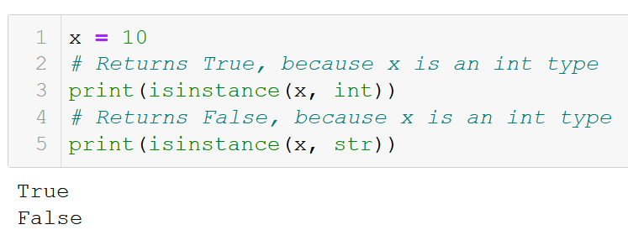
Asserting on types
Another interesting function is the isinstance() one, which is used for type checking.
It receives two arguments.
The first one is a variable,
The second a type (int, float, str, list, etc.)
It returns True, if the variable is of said type and False otherwise.

Slide 23
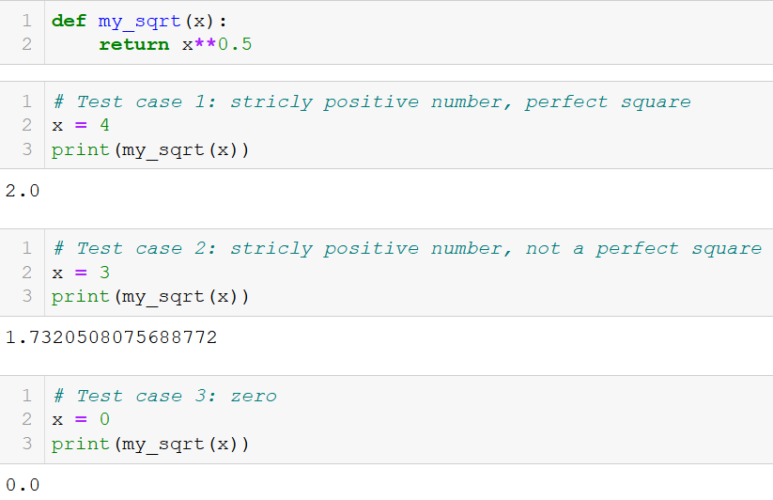
An application example: our sqrt function

Slide 24
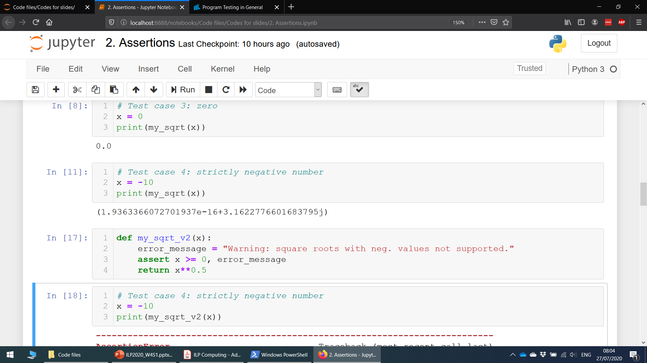
An application example: our sqrt function

Slide 25
An application example: our sqrt function

Slide 26
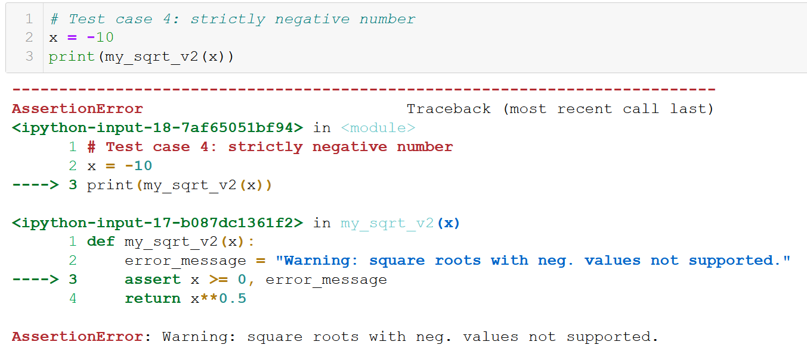
An application example: our sqrt function

Slide 27
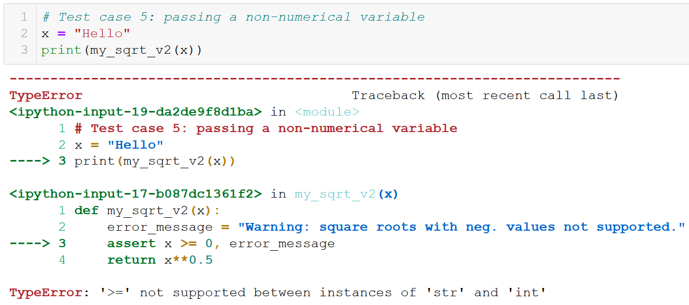
An application example: our sqrt function

Slide 28
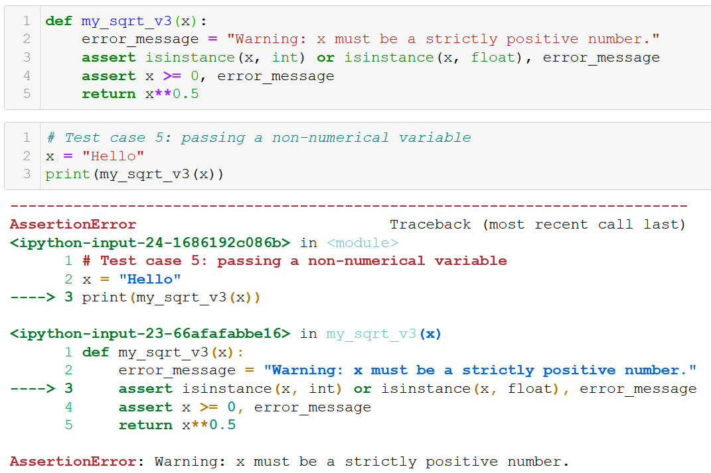
An application example: our sqrt function

Slide 29
What makes a good function?
We can define a good function as
A function that is able to operate on any of its “normal” test cases (strictly positive numbers for sqrt)
A function that is able to cover for special cases (empty lists, division by zero, etc.)
A function that raises explicative errors, if it is misused by the user (wrong variable type, not implemented feature, etc.)

Slide 30
What makes a good function?
We can define a good function as
A function that is able to operate on any of its “normal” test cases (strictly positive numbers for sqrt)
A function that is able to cover for special cases (empty lists, division by zero, etc.)
A function that raises explicative errors, if it is misused by the user (wrong variable type, not implemented feature, etc.)
(A function that produces results as fast as possible)

Slide 31
What makes a good function?
We can define a good function as
A function that is able to operate on any of its “normal” test cases (strictly positive numbers for sqrt)
A function that is able to cover for special cases (empty lists, division by zero, etc.)
A function that raises explicative errors, if it is misused by the user (wrong variable type, not implemented feature, etc.)
(A function that produces results as fast as possible)

Slide 32
What makes a good function?
We can define a good function as
A function that is able to operate on any of its “normal” test cases (strictly positive numbers for sqrt)
A function that is able to cover for special cases (empty lists, division by zero, etc.)
A function that raises explicative errors, if it is misused by the user (wrong variable type, not implemented feature, etc.)
(A function that produces results as fast as possible)
→ Start small, progressively build up the function with more features!

Slide 33
From unit testing to integration testing
It is considered good practice to perform unit tests on ALL the functions you design, to control that they operate as expected.

Slide 34
From unit testing to integration testing
It is considered good practice to perform unit tests on ALL the functions you design, to control that they operate as expected.
It is also essential to perform integration testing.
Integration testing: testing that several subfunctions are able to operate correctly when assembled together in a larger program.

Slide 35
From unit testing to integration testing
It is considered good practice to perform unit tests on ALL the functions you design, to control that they operate as expected.
It is also essential to perform integration testing.
Integration testing: testing that several subfunctions are able to operate correctly when assembled together in a larger program.
Especially important when “patching” a function: slightly modifying a single function should not make the rest of the program (game, app, etc.) malfunction!

Slide 36
From unit testing to integration testing
It is considered good practice to perform unit tests on ALL the functions you design, to control that they operate as expected.
It is also essential to perform integration testing.
Integration testing: testing that several functions are able to operate correctly when assembled together in a larger program.
Especially important when “patching” a function: slightly modifying a single function should not make the rest of the program (game, app, etc.) malfunction!
TO BE COVERED IN ADVANCED CLASSES IN SUTD!

Slide 37
Error messages
Error messages are exceptions, which were caught by the Python compiler program, when it attempted to execute your code.
Typically, assertions, which did not pass, so that the program could execute normally.

Slide 38
Error messages
Error messages are exceptions, which were caught by the Python compiler program, when it attempted to execute your code.
Typically, assertions, which did not pass, so that the program could execute normally.
They usually consist of an approximate location of where the error occurred,
And a standardized error message, attempting to explain the type of error encountered.

Slide 39
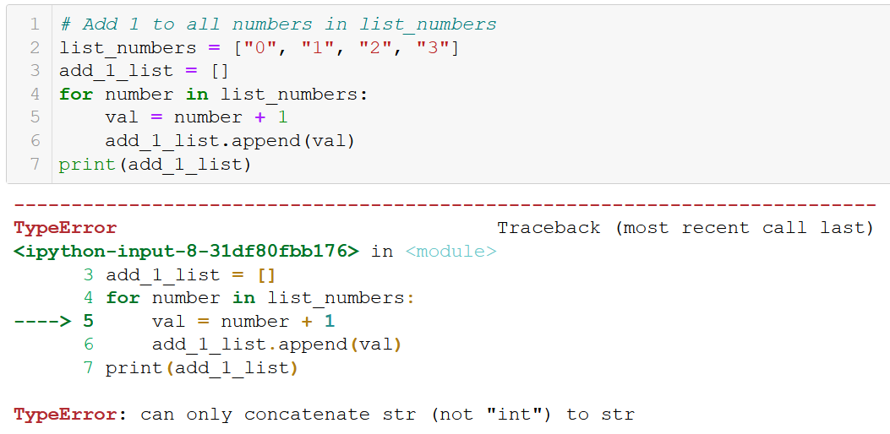
Error messages

Slide 40
Error messages

Slide 41
Error messages

Slide 42
Error messages

Slide 43
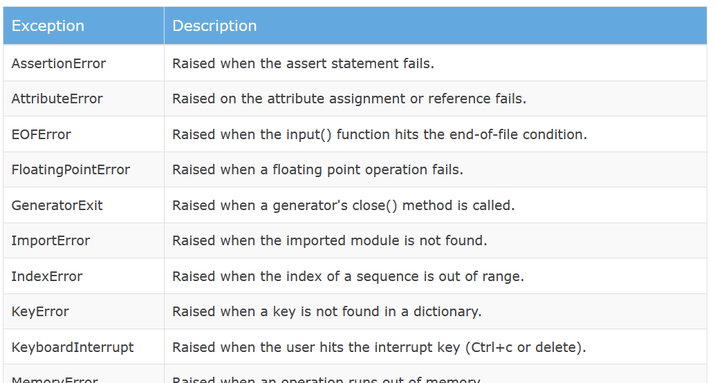
Typical error types
Learn more: https://www.tutorialsteacher.com/python/error-types-in-python

Slide 44
Debugging
Debugging is the art/process of detecting and removing of existing and potential errors (also called as 'bugs') in a code that can cause it to behave unexpectedly or crash.
To debug a program, the developer (you) has to
start with a problem,
isolate the source of the problem,
and then propose a fix for it.

Slide 45
Debugging: 1&2. isolating a problem
Python will try its best to provide a location of where the error occurred in its error message.
Unfortunately, it is not always good info.
It is often a good idea to try and pinpoint the location of the error, with some prints, to control which parts of the program work fine and which do not.

Slide 46
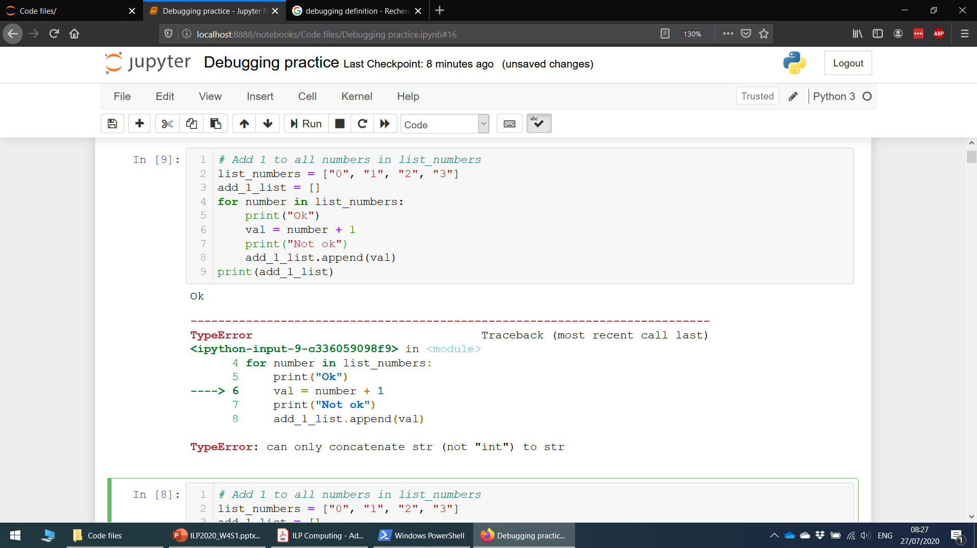
Debugging: 1&2. isolating a problem

Slide 47
Debugging: 1&2. isolating a problem

Slide 48
Debugging: 3. Fixing the problem
The error message indicates that Python was not able to sum a number (int), with a block of text (string).
Why did this occur?
And how do I fix it?

Slide 49
Debugging: 3. Fixing the problem
Contains strings of digits, not number type!

Slide 50
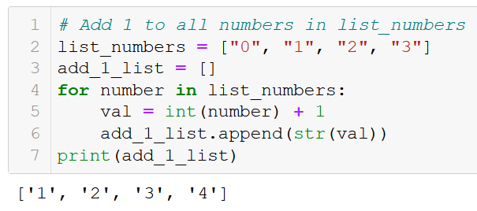
Debugging: 3. Fixing the problem
Proposed fix: convert to int/float before summing, convert back to str at the end.

Slide 51
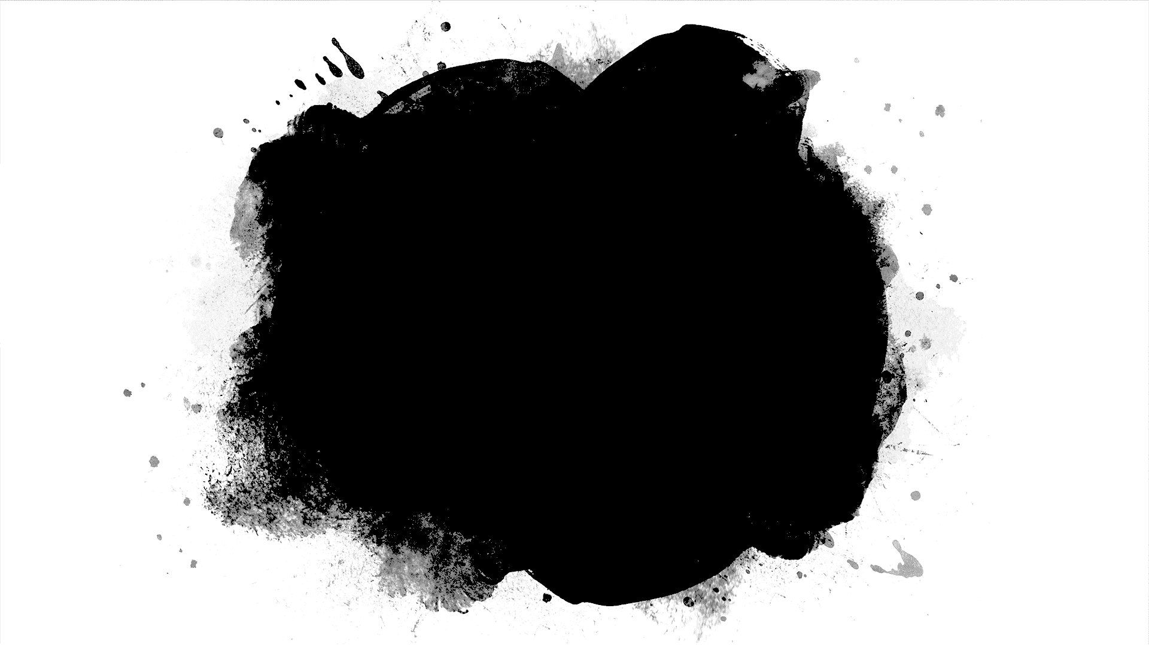
Let us practice some debugging!
Open the “Debugging practice” notebook for some typical examples of bugs and debugging!

Slide 52
Conclusion
Testing
Unit testing
Assertion testing
Integration testing
Debugging and practice

Slide 53
Also
I have uploaded some of the activities from last year’s summer school, in case you would like to practice before the midterm exam!
Don’t overdo it though!

